Slide 1
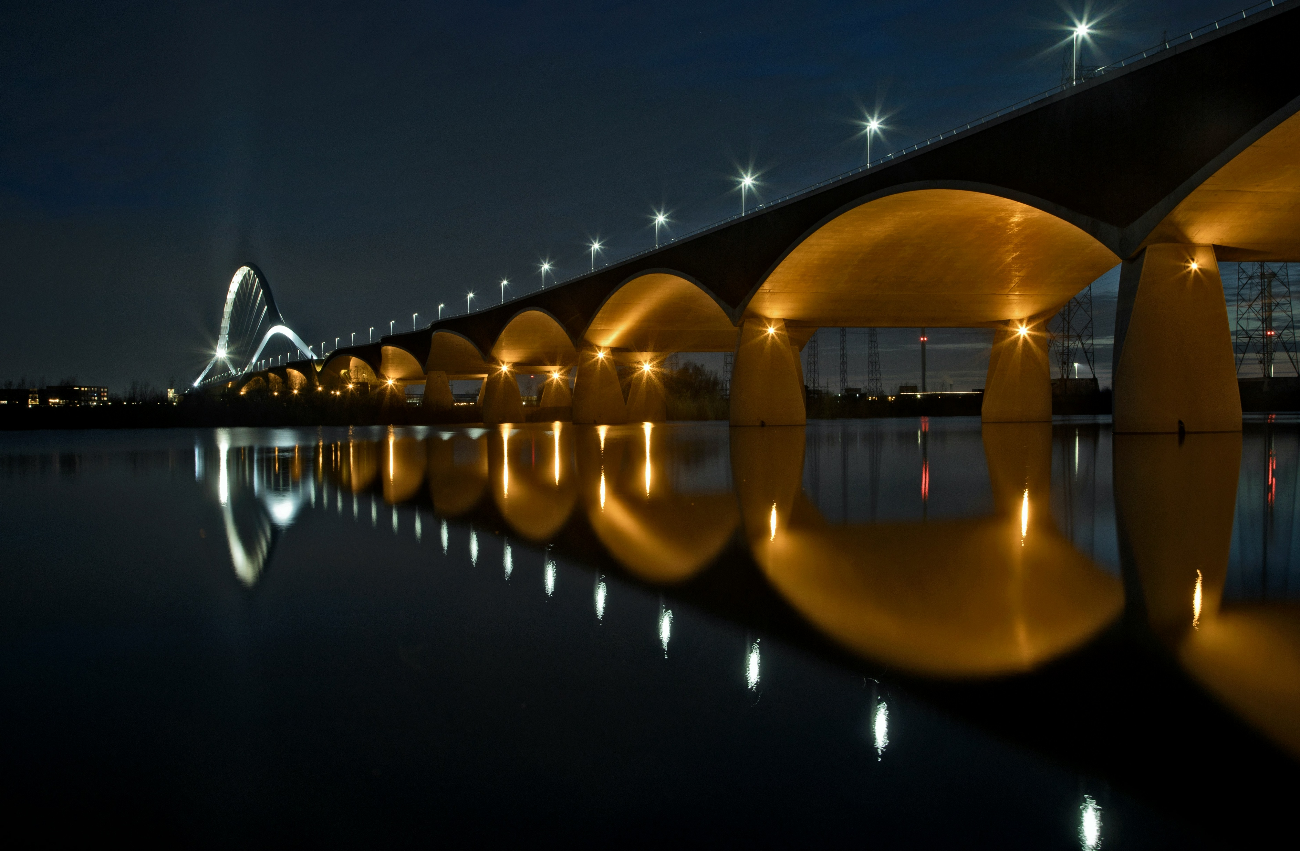
It was 20 years ago today
OER in The Netherlands
25 November 2025

Slide 2
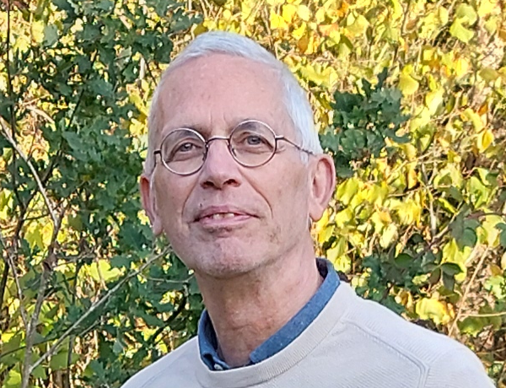

About me
Robert Schuwer
Based in Malden (The Netherlands)
Married, two sons
Independent consultant and researcher OER
MSc in Mathematics (University Nijmegen) and Computer Science (Eindhoven University of Technology)
PhD @ Eindhoven University of Technology. Topic: Expert systems
Involved in “open” since 2006
2014-2022 Professor OER @Fontys University of Applied Sciences

Slide 3






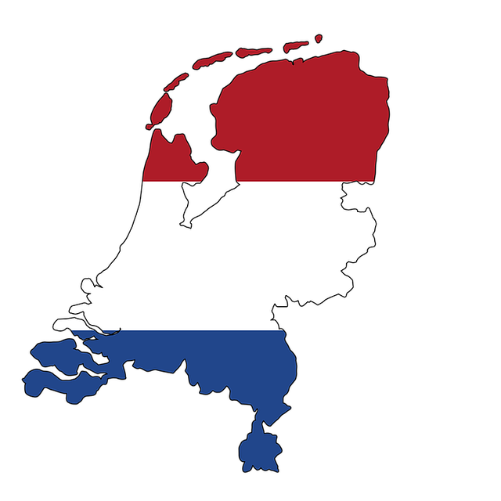





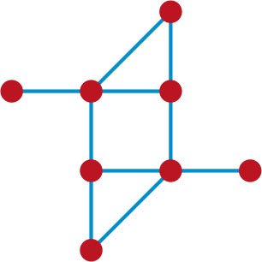



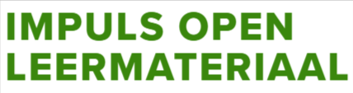
Historical timeline
2001
2002
2006
2008
2010
2012
2014
2016
2018
2023

Slide 4


Slide 5
Npuls
Npuls is a collaborative national program dedicated to future-proofing Dutch education.
By focusing on digitalization, quality, and accessibility, they aim to make learning smarter and more inclusive for everyone.
For vocational and higher education
Duration 2022-2030
Financed by the Dutch government (~€600M)
https://npuls.nl/en

Slide 6
Npuls: core ambitions
Obstacle-Free Learning
Ensuring education is flexible and accessible, allowing every student to learn without physical or digital barriers.
High-Quality Education
Leveraging technology not just for efficiency, but to maintain and elevate the standard of education across all institutions.
Smart AI & Data Use
Implementing artificial intelligence and study data in an ethical, secure, and effective manner to enhance learning outcomes.

Slide 7
OER in Npuls
Focus on optimal mix from open, semi-open and commercial learning materials
Aiming at FAIR (Findable, Accessible, Interoperable, Reusable) learning materials
Enhancing technical infrastructure
Repository (edusources and wikiwijs)
Creating collections
Stimulating and supporting community building
https://edusources.nl/

Slide 8
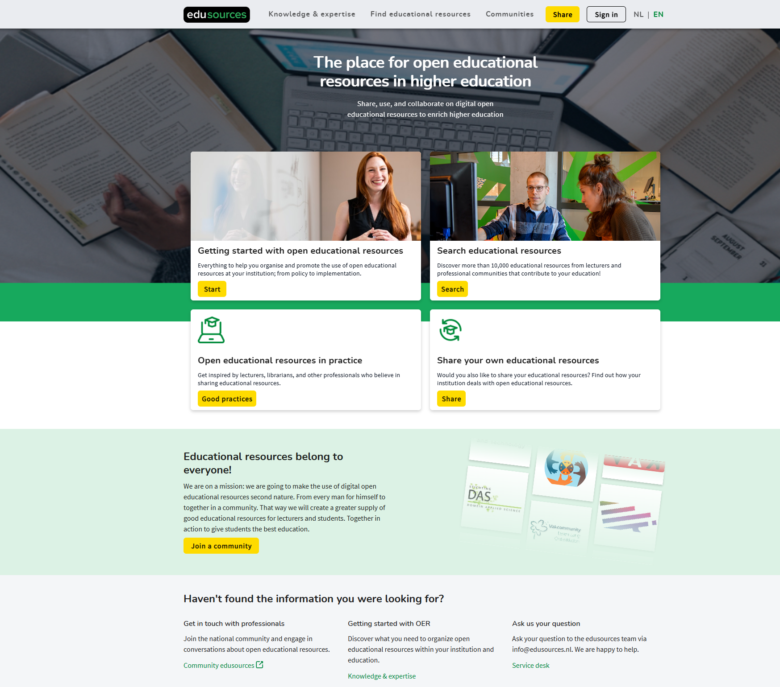

Slide 9



Titel

Slide 10
Impuls open leermateriaal (IOL)
Open leermateriaal = OER
IOL encourages the use of open educational resources in primary and secondary education.
support schools in finding, using, creating and sharing open educational resources,
with the aim of improving the quality of education and
making the teaching profession more attractive.
Duration 2022-2030
Financed by the Dutch government (~€80M)
https://www.openleermateriaal.nl/

Slide 11
IOL: ambition
In the classroom:
Open educational resources are a fully-fledged option for all teachers in primary and secondary education.
In the sector:
Strengthening the quality of education and increasing the attractiveness of the teaching profession
through collective management of high-quality open educational resources in primary and secondary education,
linked to core objectives and attainment targets,
in a sustainable organisational form.

Slide 12
Background: primary and secondary education in the Netherlands
Primary education: 4-12 years
Secondary education: 12-16/18 years
National core objectives and attainment targets, assessed nationally
“Methods” from commercial publishers
Set of learning materials (in most cases primarily textbooks)
Covering all core objectives and attainment targets per subject
In a continuous learning pathway for all years
Based on a didactic approach
Provides teachers with guidance
But are also expensive and difficult to adapt to a specific context
And that is where OER play a role

Slide 13
IOL: approach
Financing and supporting pilot projects with open educational resources.
Developing a quality system for open educational resources.
Conducting research into the effective use of open educational resources.
Developing knowledge (products) to use open educational resources effectively.
Improving the ICT infrastructure.

Slide 14
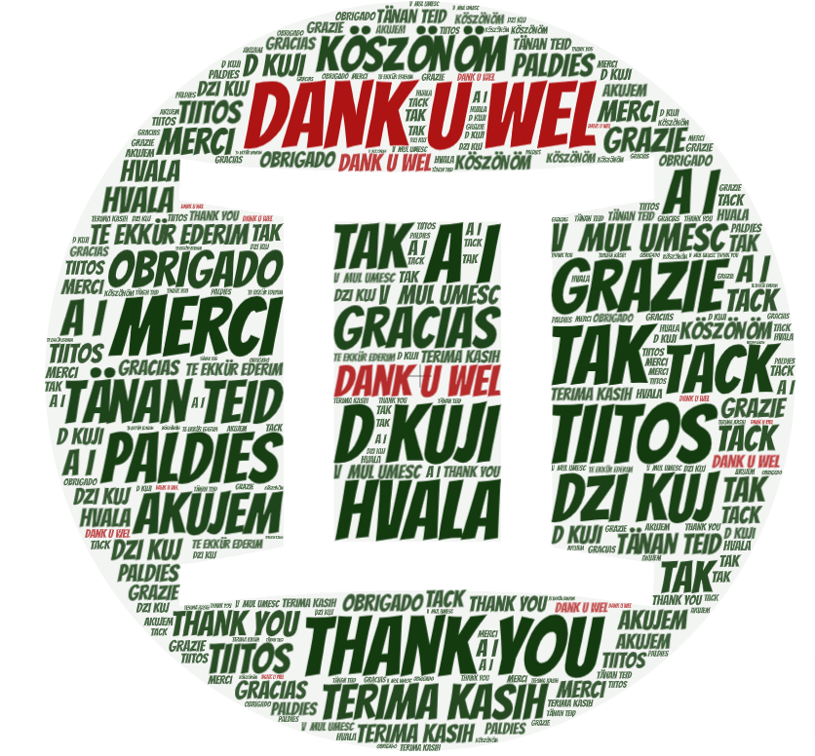

robert@robertschuwer.nl

Slide 15
Colophon
This presentation is published under a Creative Commons Attribution 4.0 International (CC BY 4.0) license.
One element is available under a more restricted license:
Npuls logo: CC BY-SA https://npuls.nl/en/communication-kit
When reused, use the reference:
Schuwer, R. (2025, November 25). It was 20 years ago today [PowerPoint]. OER Consultancy. https://robertschuwer.nl/download/slides/20251125/oerbarcamp.pptx
Images
Cover: CC0 by Leo Vullings
Logo Impuls open leermateriaal: CC BY by IOL
Thank you: CC0 by Robert Schuwer

